Slide 1

Chatbot for mental health and support
Group Members :-
AP21110010844 – Namala Vamsi
AP21110010788 –Hitish Kavati
AP21110010803 – Sanjay Panchala
AP21110011236- Teja Potteti
Mentor : Dr Randir Kumar

Slide 2
List of Contents
Inroduction
Features
Software and hardware requirements
Libraries and models used
Execution Screanshots
Limitation , Future scope and Conclusion

Slide 3
Introduction
The Mental Health Support Chatbot is a helpful AI-based application that assists people who may be facing mental health challenges. The chatbot provides a safe and private space for users to talk about their feelings and ask for advice. It can offer support, answer questions, and guide users to useful resources in a friendly and understanding way
Comparison with Traditional Systems
- Offers a convenient, accessible alternative to traditional face-to-face mental health support.
- Provides immediate responses and resources, allowing users to seek help anytime.
- Users can access assistance anonymously and at their own pace.

Slide 4

Features
User Authentication: Securely create accounts and access personalized support.
Text-based Communication: Chat naturally with the chatbot using text input.
Data Preprocessing: Preprocess input text for better understanding and accuracy.
Relevant Response Generation: Used TF-IDF and cosine similarity for the best responses.
User-friendly Interface: Intuitive interface with Tkinter for seamless interaction.
.

Slide 5
Software and Hardware Requirements
Software:
Python: Version 3.8+ with required libraries (pandas, nltk, scikit-learn, tkinter, transformers, sqlite3).
Database: SQLite for data storage.
Internet: Required for accessing models and resources.
Hardware:
Processor: Dual-core or quad-core.
Memory: 4GB RAM.
Storage: 10GB available space.
Display: Standard monitor.

Slide 6
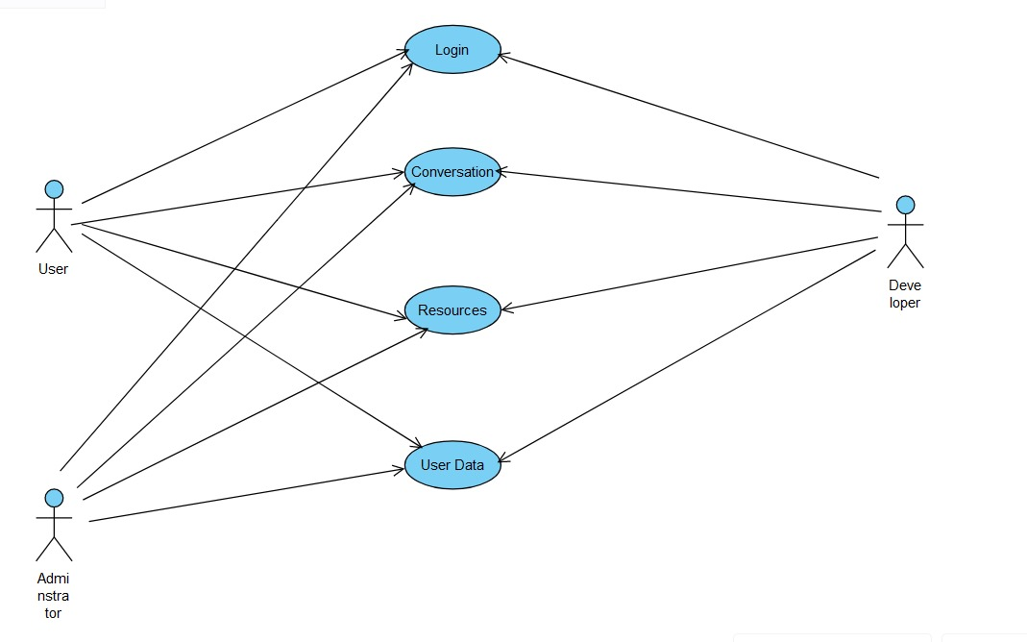
Use case Diagram

Slide 7
Libraries and Models Used
1. Frontend Part
Tools:
Tkinter for GUI creation.
2.Backend Part
Libraries:
nltk: For natural language processing tasks (tokenization, stopword removal, lemmatization).
scikit-learn: For TF-IDF vectorization and cosine similarity.
3. Database Connections
Libraries:
sqlite3: For SQLite database management.
Database:
SQLite.
4.Algorithms used in Backend
TF-IDF Vectorization:
Converts text input into numerical vectors based on term frequency-inverse document frequency (TF-IDF) values.
Cosine Similarity:
Measures the similarity between user input vectors and preprocessed responses to find the most relevant response.

Slide 8
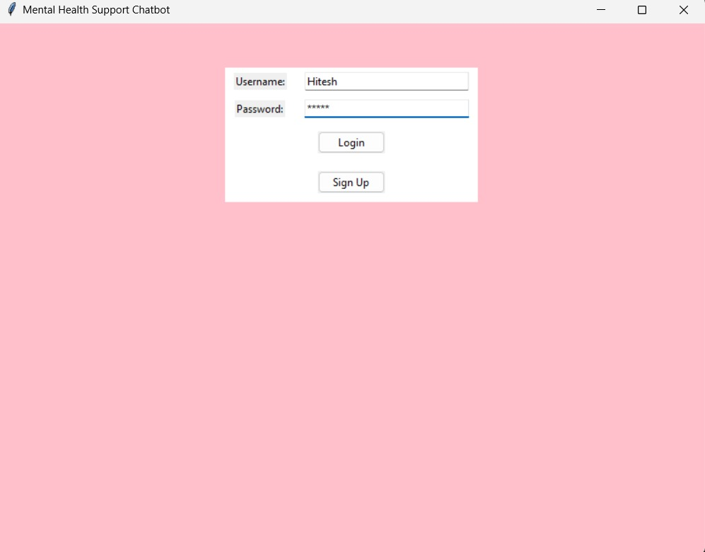
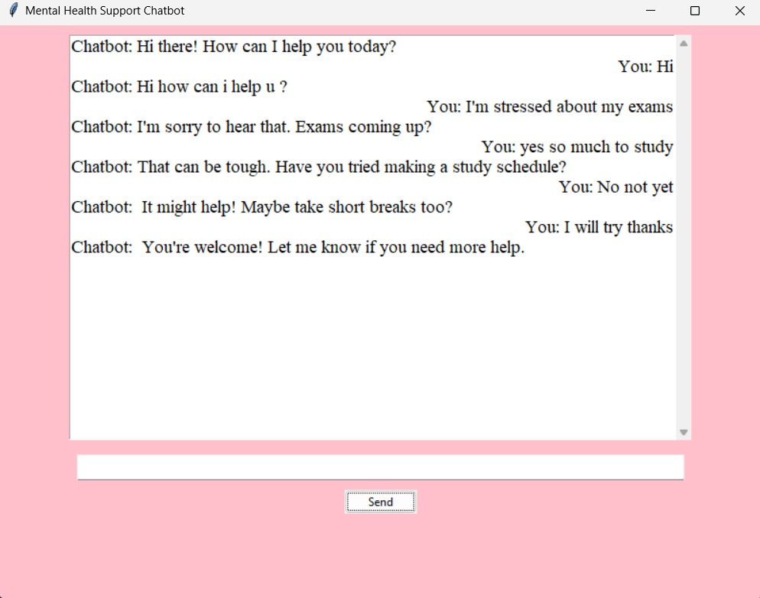
Execution screanshots

Slide 9
Limitations
Limited Responses: May not address all user queries fully.
Personalization: Current model may lack deeply personalized responses.
Ethical Concerns: Ensuring data privacy and responsible handling of user conversations.
Future Scope
Personalized Responses: Use advanced ML for more personalized answers.
Sentiment Analysis: Integrate emotional intelligence in responses.
Multimedia Features: Add voice and multimedia communication options.

Slide 10
Conclusion
The Mental Health Support Chatbot provides immediate and accessible support for individuals facing mental health challenges. Utilizing AI and NLP, it offers a safe space for users to express their feelings and seek guidance. Although there are limitations, such as reliance on predefined responses and privacy concerns, future enhancements like advanced ML and multimedia integration promise improved personalization and empathetic support.

